Slide 1
DS 4300
Redis + Python
Mark Fontenot, PhD
Northeastern University

Slide 2
Redis-py
Redis-py is the standard client for Python.
Maintained by the Redis Company itself
GitHub Repo: redis/redis-py
In your 4300 Conda Environment: pip install redis
Notes:
Value can be any arbitrary data (string, number, JSON object, binary object, etc)

Slide 3
Connecting to the Server
import redis
redis_client = redis.Redis(host=’localhost’,
port=6379,
db=2,
decode_responses=True)
For your Docker deployment, host could be localhost or 127.0.0.1
Port is the port mapping given when you created the container (probably the default 6379)
db is the database 0-15 you want to connect to
decode_responses → data comes back from server as bytes. Setting this true converter them (decodes) to strings.

Slide 4
Redis Command List
Full List > here <
Use Filter to get to command for the particular data structure you’re targeting (list, hash, set, etc.)
Redis.py Documentation > here <
The next slides are not meant to be an exhaustive list of commands, only some highlights. Check the documentation for a complete list.

Slide 5
String Commands
# r represents the Redis client object
r.set(‘clickCount:/abc’, 0)
val = r.get(‘clickCount:/abc’)
r.incr(‘clickCount:/abc’)
ret_val = r.get(‘clickCount:/abc’)
print(f’click count = {ret_val}’)

Slide 6
String Commands - 2
# r represents the Redis client object
redis_client.mset({'key1': 'val1',
'key2': 'val2',
'key3': 'val3'})
print(redis_client.mget('key1',
'key2',
'key3'))
# returns as list [‘val1’, ‘val2’, ‘val3’]

Slide 7
String Commands - 3
set(), mset(), setex(), msetnx(), setnx()
get(), mget(), getex(), getdel()
incr(), decr(), incrby(), decrby()
strlen(), append()

Slide 8
List Commands - 1
# create list: key = ‘names’
# values = [‘mark’, ‘sam’, ‘nick’]
redis_client.rpush('names',
'mark', 'sam', 'nick')
# prints [‘mark’, ‘sam’, ‘nick’]
print(redis_client.lrange('names', 0, -1))

Slide 9
List Commands - 2
lpush(), lpop(), lset(), lrem()
rpush(), rpop()
lrange(), llen(), lpos()
Other commands include moving elements between lists, popping from multiple lists at the same time, etc.

Slide 10
Hash Commands - 1
redis_client.hset('user-session:123',
mapping={'first': 'Sam',
'last': 'Uelle',
'company': 'Redis',
'age': 30
})
# prints:
#{'name': 'Sam', 'surname': 'Uelle', 'company': 'Redis', 'age': '30'}
print(redis_client.hgetall('user-session:123'))

Slide 11
Hash Commands - 2
hset(), hget(), hgetall()
hkeys()
hdel(), hexists(), hlen(), hstrlen()

Slide 12
Redis Pipelines
Helps avoid multiple related calls to the server → less network overhead
r = redis.Redis(decode_responses=True)
pipe = r.pipeline()
for i in range(5):
pipe.set(f"seat:{i}", f"#{i}")
set_5_result = pipe.execute()
print(set_5_result) # >>> [True, True, True, True, True]
pipe = r.pipeline()
# "Chain" pipeline commands together.
get_3_result = pipe.get("seat:0").get("seat:3").get("seat:4").execute()
print(get_3_result) # >>> ['#0', '#3', '#4']

Slide 13
Redis in Context

Slide 14
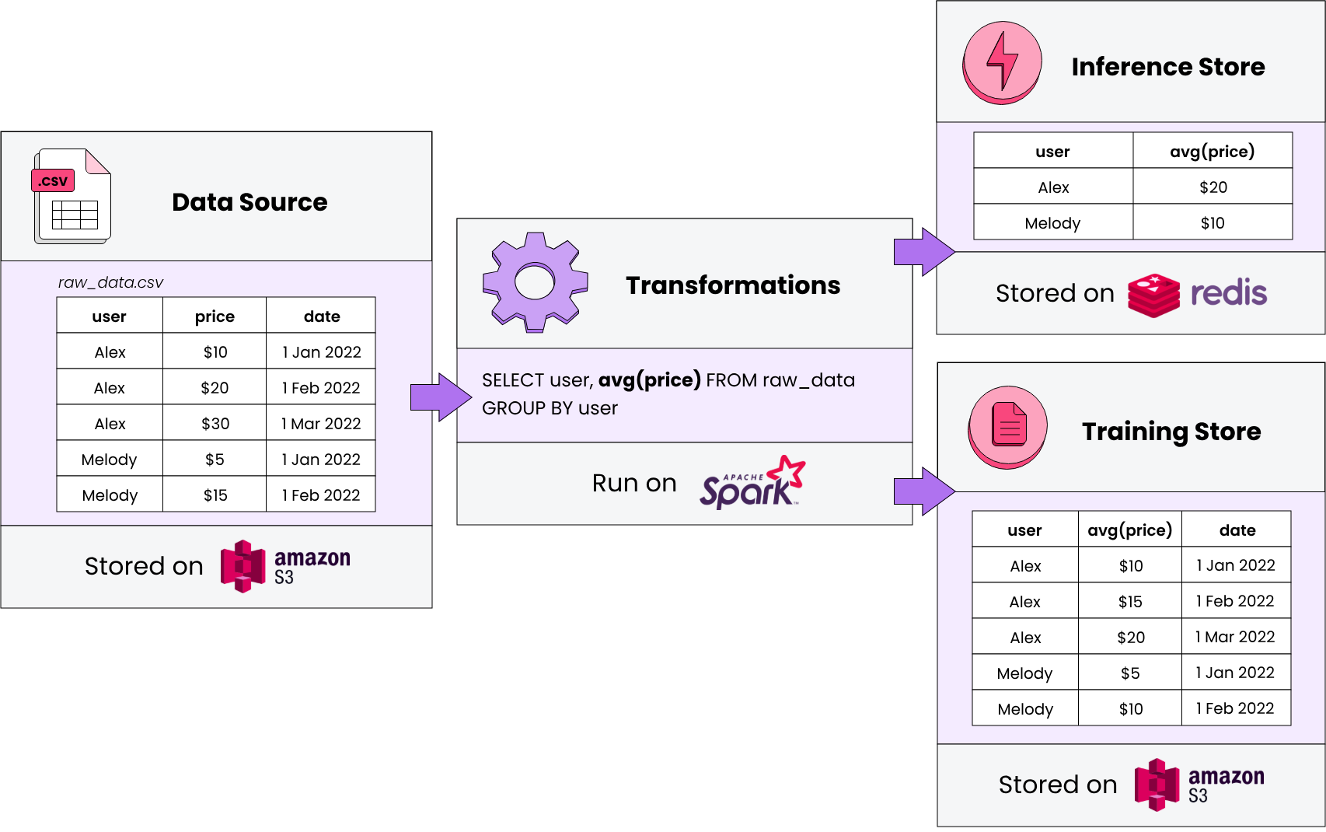
Redis in ML - Simplified Example
Source: https://www.featureform.com/post/feature-stores-explained-the-three-common-architectures

Slide 15
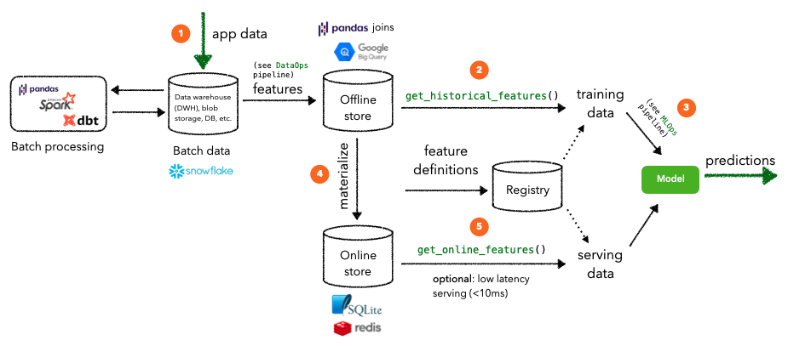
Redis in DS/ML
Source: https://madewithml.com/courses/mlops/feature-store/

